Slide 1
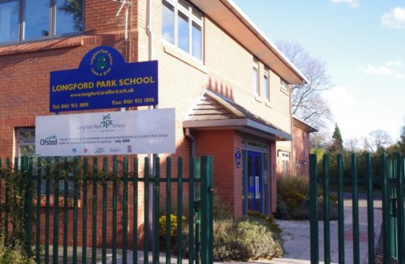
Our Song
Believe, Belong, Become ...
Longford Park School

Slide 2
I believe I belong I’ll become who I’ll be
I’ll break the walls down as my fear falls down
I’ll stay true I’ll stay strong I’ll succeed in my own way
One day I’ll know -
If I try there’s just no telling how far - I’ll go

Slide 3



Until I know I’ll never go,
Free like a child into the wild,
Home is wild Longford Park is mild,
Football is good but school is better,
Like chedder only even better,
You’ll never know until you try,
Oh go on then do a rhyme,
Just kidding have some time,
Work hard as a shark,
At Longford Park,

Slide 4
I believe I belong I’ll become who I’ll be
I’ll break the walls down as my fear falls down
I’ll stay true I’ll stay strong I’ll succeed in my own way
One day I’ll know -
If I try there’s just no telling how far - I’ll go

Slide 5
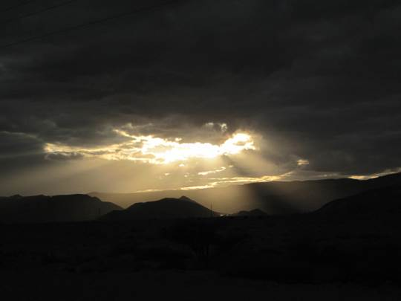
Some say,
Sunlight only shines in,
Darkness, that’s why I look best,
Like you

Slide 6

KS1 progress – Daniel Bullock
KS2 progress – Alisha B
2016 - 2017
There's only one person I can be
If I can't be you then I must be me
And the view from here as far as I can see
This is my one life not two or three
Outstanding pupil of the year – Bradley Turner
2016 - 2017

Slide 7


Mary Hadfield Award – Warren D
2016 - 2017
There's nothing in life you can't achieve
If I just stay true and in myself believe
Not talking 'bout YouTube or TV
Cos all that stuff ain’t reality
Music KS1 – Kamlyn
Music KS2 – Cameron S
(chosen by Vic) 2016 - 2017

Slide 8


Sports KS1 – Joshua C-L
Sports KS2 – O’Neil S
2016 - 2017
Cos this is my life and this is what's real
It's the people and places that make me feel
I belong in the 21st century
I'm a shining star in society

Slide 9


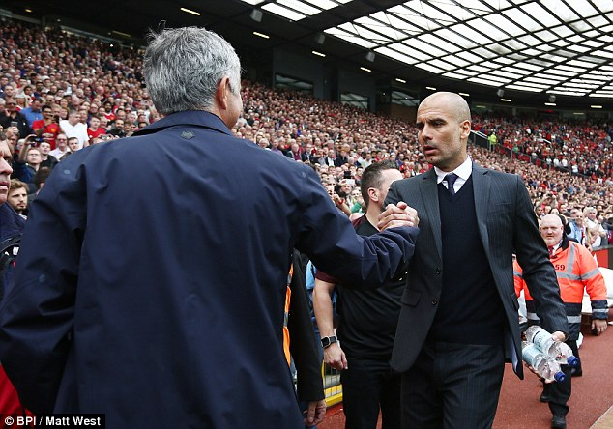

You could be black or white or red or blue
But it really doesn’t matter cos there's only one you
And if you try your best and reach up high
You'll become the person who learns to fly

Slide 10
I believe I belong I’ll become who I’ll be
I’ll break the walls down as my fear falls down
I’ll stay true I’ll stay strong I’ll succeed in my own way
One day I’ll know -
If I try there’s just no telling how far - I’ll go

Slide 11

I believe who I am I believe what I can
I believe the person that I want to be
And that person is me

Slide 12
I believe I belong I’ll become who I’ll be
I’ll break the walls down as my fear falls down
I’ll stay true I’ll stay strong I’ll succeed in my own way
One day I’ll know -
If I try there’s just no telling how far - I’ll go

Slide 13

We believe We belong We’ll become who we’ll be
We’ll break the walls down as our fear falls down
We’ll stay true We’ll stay strong We’ll succeed in our own way
One day we’ll know -
If we try there’s just no telling how far - we’ll go

