Slide 1
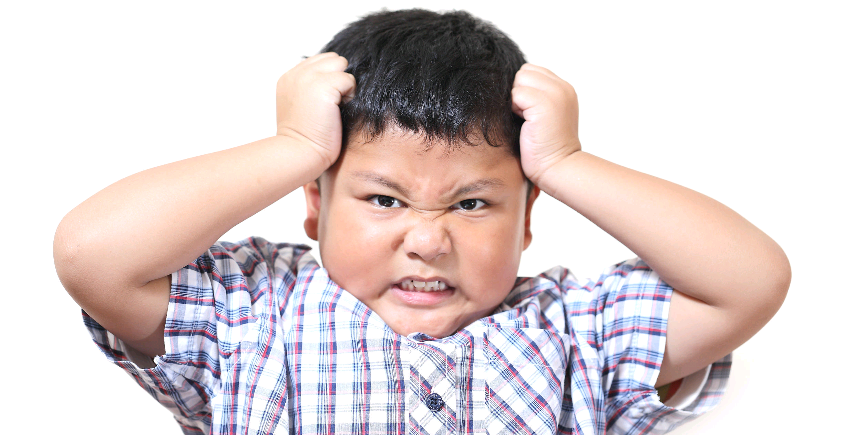
Helping Children to Regulate their Emotions and Behaviours
Sue Hawkins
Practitioner Psychologist

Slide 2
How do Children Learn to Regulate?
Through early attachments, especially first year of life
Through social learning, via positive role models
N.B. intrinsic factors, such as ASC/ADHD/FAS also come into play

Slide 3
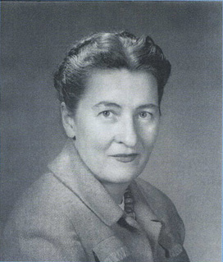
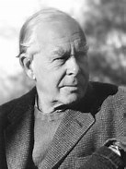
Origin of Attachment Theory: John Bowlby & Mary Ainsworth
Ainsworth U.S. psychologist- ‘strange situation’ experiment…how young children experience separation from mother...led to theory of attachment styles
Bowlby - psychiatrist working with emotionally disturbed children in UK in 1930s – attachment needed for social, emotional & cognitive development

Slide 4
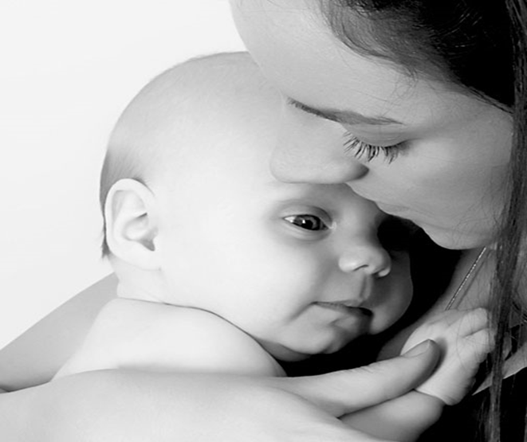
Modern Attachment Theory
Looks at the neuroscience of attachment.
Mirroring/attunement in early attachments shapes our brains & this impacts upon our ability to emotionally regulate, as well as many cognitive functions.
Dr Allan Schore (video clip)

Slide 5
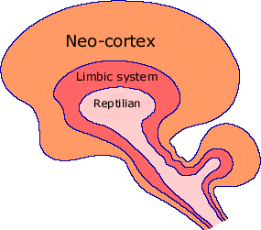
Evolution of the Brain

Slide 6
Evolution of the Brain
Reptilian brain – oldest part – instinctive/primal behaviour/survival. Controls bodily functions, e.g. hunger, breathing, temperature, digestion, movement.
Limbic System / mid/mammalian brain
The emotional brain, activates fear, rage, separation distress, playfulness, sexual desires.
Pre-frontal cortex / neo cortex – newest part – 85% of brain mass. Involved in kindness, empathy, reasoning, self-awareness, problem-solving, impulse control, planning, organisational skills, (executive functions) creativity.

Slide 7
Video Clip
Dr Allan Schore

Slide 8
Executive Function
Relates to pre-frontal/neo-cortex development & functioning
Impacts on attention, freedom from distraction, consequential thinking, sequencing skills, planning, working memory & empathy skills
Co-morbid with attachment disorder, ASD, ADHD, PTSD & personality disorders

Slide 9
Brain Structure & Chemistry
Brain structure: Under stress, frontal lobes shut down - overwhelmed by cortisol & nor-adrenaline (fight/flight/freeze), limbic system kicks in (causes the amygdala to become hyperactive & affects the hippocampus, which organises memory)
Prolonged stress causes neuron death.
Brain chemistry:
Secure attachments - opioids & oxytocin released (soothing chemicals)
Insecure attachments- Uptake of ‘positive’ brain chemicals affected e.g. dopamine, serotonin. Overproduction of ‘negative’ chemicals e.g. cortisol. Stress in mother can produce high levels of cortisol in utero & over a prolonged period, causes levels to become too low – leads to withdrawal

Slide 10
In Babies…
The pre-frontal cortex comes ‘online’ at around 7-8 months
Playing with babies & mirroring connect & grow nerve fibres in the mid-brain (emotional brain) to the pre-frontal cortex & promote empathy & ability to focus
Providing comfort & joy promote the growth of these nerve fibres, as well as activating the dopamine receptors (involved in motivation/feeling pleasure in a relationship)
Fires up the ‘mirror neurons’ involved in empathy/theory of mind

Slide 11

Dysregulated Kids…
Can’t talk about their emotions/inner world because they’re hyper-vigilant to threats in the external world
They need to accomplish the 3 ‘R’s: regulation (emotions, cognitions & behaviours) reflection (ability to reflect on their inner world) relationships (sharing/reciprocity, empathy)
Their dopamine receptors may not be working well & dynorphins kick in, which suppress the need to get dopamine in a relationship: a protection against abandonment/rejection
They may go on to seek dopamine through subtances/other addictions & compulsions
Goal: we have to teach kids to get dopamine through relationship

Slide 12
Emotionally Healthy/Unhealthy Kids
Healthy kids have a Plan A: relying on others for comfort/support & a Plan B: relying on self
Unhealthy kids only have a Plan B: relying on self/staying vigilant, scaring people away/making them angry/unhappy (‘sharing/projecting the pain’), hoarding/stealing money or objects (money/objects can’t abandon them…better than people), lying (to create an alternative reality), dissociating through substances, gaming, etc

Slide 13
On a positive note…
Studies have shown that we need only 1 positive attachment figure in order to thrive & doesn’t have to be primary caregiver (Sroufe et al, 2005)
Attachments may change throughout the lifespan & supportive relationships can provide a ‘corrective attachment experience’
The brain is ‘plastic’ & continues to develop, especially up to age 30, with a highly ‘sensitive period’ in adolescence

Slide 14
What can be done to Promote Positive Attachments/Brain Development?
Providing a ‘secure base’ for young people
Providing a different ‘working model’ of attachment,e.g.encouraging/supportive/
non-rejecting/abandoning/not smothering
Empathic attunement/mirroring/emotion coaching, helps people emotionally self-regulate & has an effect on brain structure & chemistry
Understanding cognitive difficulties & targeting appropriate support with learning strategies

Slide 15
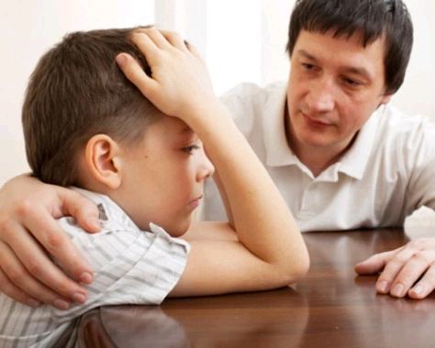
Emotion Coaching
Started in US as a parenting style (Gottman, 1996)
An approach that can be applied in any context.
Adults can empower children to build a repertoire of internal and external emotional regulatory skills that promote positive behaviours.
A model for promoting empathetic responses that nurture emotionally supportive relationships/secure attachments.
Optimal context for promotion of resilience and positive mental health.
Draws on best evidence from neuroscience, developmental psychology, attachment theory.

Slide 16
Impact of Emotion Coaching
Clinically researched, US and Australia, randomised control trials.
Increase in adult and child self-regulation, reduction in emotional dismissing (co-regulation).
Enhanced social relationships with and between children and young people.
Enhanced wellbeing & mental health.
Reduction in disruptive behaviour, externalising behaviour.
Improved relationships, development of social/emotional competencies, increases ability to reflect on inner life
Reduction in use of sanctions and rewards i.e. school exclusions.
Used successfully with complex trauma/PTSD, ASD, attachment difficulties, depression & anxiety.

Slide 17
Emotional Containment
Containment is where a person receives and understands the emotional communication of an other without being overwhelmed by it and communicates this back to the other. The aim is that another person is able to hold onto/be the ‘container’ for painful feelings and then give them back detoxified and bearable.
(Wilfred Bion, 1954)

Slide 18
Emotional Containment
We have to be able to contain our own emotions when working with traumatised kids.
They might test us/challenge us, find our Achilles heals/press our buttons, albeit often unconsciously.
We also need support & containment also when working with these young people.

Slide 19
Skills of Emotion Coaching
Tuning into the young person’s emotion/inner world.
Accepting all emotions as ‘normal’ & validating them.
Recognising attuning to emotion as an opportunity for connection/brain re-wiring.
Listening empathetically to their words and non-verbal communication e.g. gesture & tone of voice.
Helping the person to verbally label their emotions.
Regulating ourselves as we’re hearing their distress.
Matching their ‘rhythm of distress’, through our own words, gestures & tone of voice.
Setting limits, while helping the person to problem- solve.
Being ‘real’/genuine...hyper-vigilant kids in particular will see right through fake empathy!

Slide 20
Step 1 i. Active Listening
Active listening is more than just hearing the words that someone is saying
It means attuning to their emotions (verbally stated or not)
It means picking up on non-verbal cues, such as body language/facial expressions/tone of voice/what they’re not saying.

Slide 21
Step 1. ii. Reflecting
Reflecting means using words to reflect back the young person’s emotion, stated or not. This helps the young person to label emotion, e.g. “You sound/look frustrated”
It’s important to have a good emotional repertoire as a practitioner, so you can reflect the emotion accurately, e.g. ‘irritated/frustrated/angry/furious’
You can reflect the exact words the person says or use your own words. Try to match the tone of their expression as well as the words.

Slide 22
Step 1: iii. Validating the Emotion
Validating means accepting and normalising the emotion, e.g. “I know that you get angry when people don’t listen to you”.
Validating avoids shaming the young person for having that emotion.
It teaches that the emotion is a ‘normal’ response to a difficult situation.
It fires up mirror neurons & makes them feel emotionally contained.

Slide 23
Importance of Step 1 Skills
Sensing, naming and identifying what is going on is the first step to recovery
Being able to hover calmly over our thoughts, feelings and emotions and then take time to respond, allows the executive function brain to inhibit, organise and moderate the hardwired autonomic reactions programmed into the emotional mid-brain. (Bessel Van der Kolk), 2014.

Slide 24
Examples of Empathic Responses
“You look quite low and withdrawn today…I wonder if you’re finding it hard to talk? Maybe you want to talk but it’s hard or maybe the best we can do right now is just sit in silence?”.
“You must have felt really angry when that happened.”
“I notice that you get really triggered when people dismiss you or don’t listen to you.”
“That must have felt really unfair”.
“It sounds like you felt really hurt when X did that.”
“I understand why you’re feeling pissed off about that.”
“It’s normal to feel sad when we have such a big loss in our lives.”
“I totally get why you feel the way you do.”
“It seems like your body is tense & you’re really stressed today.”

Slide 25
Demonstration & Practice of Step 1 skills
Active Listening
Reflecting
Validating the Emotion

Slide 26
Step 2: Setting limits (if needed) without shaming the young person
“I understand how you feel but I’m certain there’s a better way of dealing with these emotions that I can help you with.”
“Laws are there to protect people.”
“I want to help you to manage your feelings without hurting yourself or anyone else.”
“It seems that alcohol & drugs play a big part in your losing control. I think that’s something we need to address.”
“I understand that you were annoyed with your mum because she doesn’t listen but there are more skilful ways to deal with these feelings than lashing out at her.”

Slide 27
Step 3: Problem-Solving with the Young Person
When the young person is calm and in a relaxed, rational state:
Explore the feelings that gave rise to the behaviour, problem, incident.
Scaffold alternative ideas and actions that could lead to more appropriate and productive outcomes…ideally get them to suggest what they could have done differently.
Empower the y.p. to believe s/he can overcome difficulties and manage feelings/behaviour. Use a ‘solution-focused’ technique, e.g. “Are there times when this has happened & you haven’t done X? How did you manage to do that? “

Slide 28
Problem-Solving Examples
“How do you feel right now?”
“What you could have done differently to avoid getting involved in that argument?”
“Can you think of what to do next time you feel this way?”
“Can we make a list of different ways of dealing with feeling that angry?”
“Is there anything you could have done before you get to the point of harming yourself?”
“How does your body let you know that you’re getting stressed? What are the signs?”

Slide 29
Demonstration & Practice of step 2 & 3 skills
Setting limits
Problem-solving

Slide 30
Self-regulation Skills/Modelling good attachments
We don’t have to be perfect but we are role models to y.p.
We need to manage our emotions & model good attachments, repairing relationships when they go wrong.
In attachment theory this is called rupture & repair, e.g. “I’m sorry I got angry with you…sometimes I get stressed too.” “I’m sorry you thought I criticised you, that wasn’t my intention”. “I’m sorry I had to cancel our last session…I was wondering how you were doing”.

Slide 31
Further Reading/Resources
‘Inside I’m Hurting’, Louise Michelle Bomber
‘Why Love Matters’, Sue Gerhardt

