Slide 1

Welcome to
Class Newiss

Slide 2
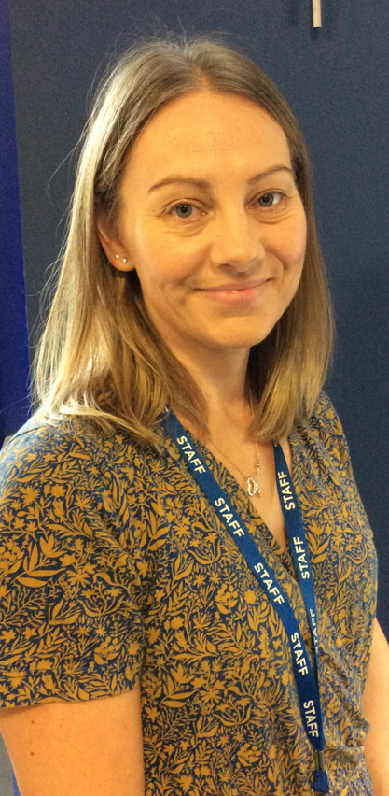
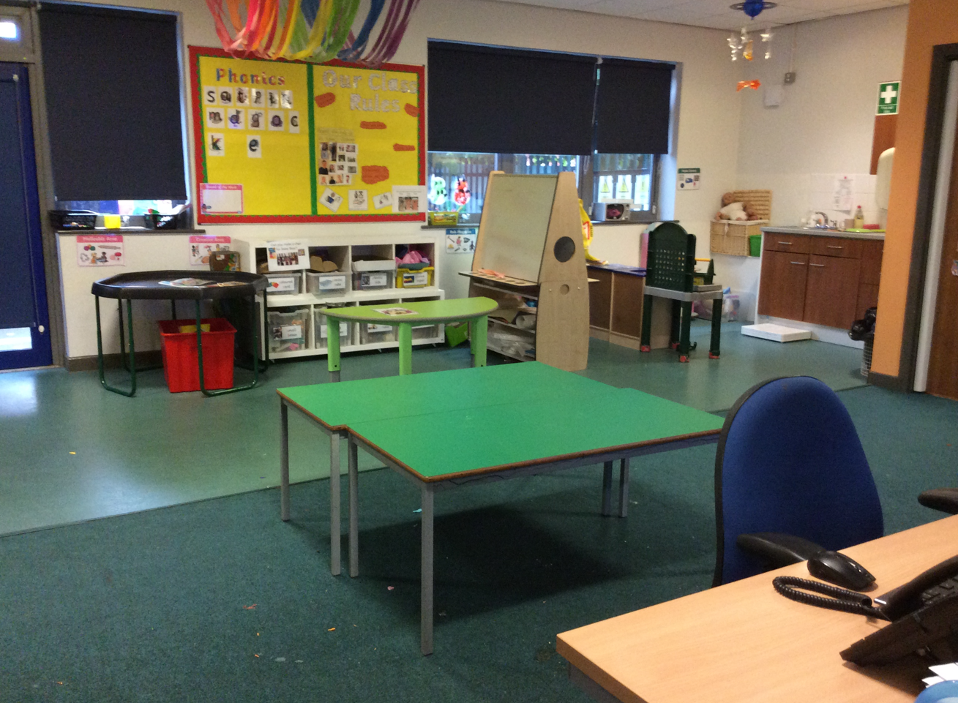
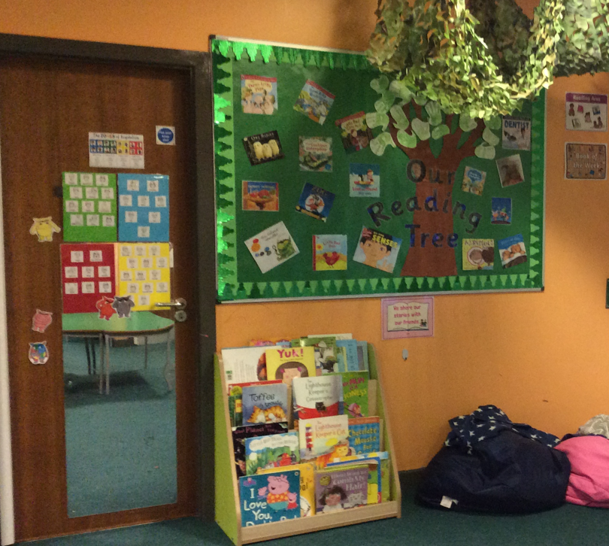
Welcome to Class Newiss!
In Class Newiss your teacher will be Mrs Newiss. She will be supported by an experienced teaching assistant, Miss O Dare. We are both really excited to teach the children next year and we are looking forward to sharing some fantastic experiences with them at Longford Park School.
Here is our current classroom.
You may have noticed some very exciting building work being carried out at the back of school recently. When the new buildings are ready Class Newiss will be moving into one of the new classrooms!

Slide 3
Dropping off and collecting your child from school
The school day begins at 9am. All pupils enter the school by the rear door if travelling on the school bus. If an adult is dropping off they can do this at the front of school.
Pupils finish at 3:00pm each day. Many pupils travel to and from home by taxi or mini bus provided by Trafford Transport.
If somebody different is collecting your child from school, please inform school. If the teacher does not know that somebody different will be collecting your child, they will not allow your child to leave with them.
A typical school day
A typical day is set out below. Subjects will vary from day to day and a final timetable will be provided in September.
9.00am | Breakfast and Reading in class
9.30am – 10.30am | Session 1 Phonics and Literacy
10.30am – 11.00am | Snack time and Break time
11.00am – 12.00pm | Session 2 Maths
12.00pm – 1.00pm | Lunchtime – class staff sit with the children
1.00pm – 1.45pm | Session 3 History / Geography
1.45pm – 2.30pm | Session 4 Science
2.30pm – 3.00pm | Daily reflection and end of day routine

Slide 4
We will have PE and Play to Learn during which children are expected to wear a PE kit; t shirt, shorts and trainers. We recommend your child brings this into school at the start of the half term and leaves this at school to change into.
Please ensure that all items are clearly labelled and help us to encourage your child to take responsibility for their kit. We would also encourage children to practice getting dressed at home to help them be changed quickly in school.
PE days will be confirmed in September.
Book bags
Please can each child bring a bag to school each day for reading books, letters and messages. If they do not have one they are available to buy from the school office.
Any letters or reply slips, which need to be returned, can be put in your child’s book bag. The children are encouraged to check them each morning and give things in after the register.
Any money needs to be in a clearly labelled an envelope and given in to the office or to a member of our staff team at registration.
Positive Behaviour Sheet
Each day we will complete a Positive Behaviour Sheet for your child to bring home. This will include 3 positive things from the day, 2 things they could do better and your child will be asked what they are most proud of from the day. There may also be a teachers comment. If you have any queries regarding comments on the sheet please do not hesitate to us.
PE and Play to Learn

Slide 5


Reading
Your child will have a daily phonics session following the Little Wandle phonics programme in addition to reading with an adult regularly in class. You will also have access to an online reading catalogue to enable them to practise reading at home. These books will be linked to the phonics programme and include the sounds and words your child has been taught.
More information will be provided in September however, if you would like to find out more, please visit;
https://www.littlewandlelettersandsounds.org.uk/
A Reading Record will be provided and your child will also chose a weekly library book to share with you for pleasure. Please make the time to read with your child and encourage them to discuss the text as well as the illustrations. Please record each time you read with your child in the Reading Record and ensure this is brought back into school every day.
We may write notes for you in the Reading Record. It is an important communication book between home and school regarding your child’s reading progress, please ensure it is returned to school every day.
In line with school policy, if the book & record are not returned, a letter requesting £5 to replace the books will be sent home.

Slide 6


Class Dojo
Class Dojo is our school messaging service. It is a great way to communicate with the class teacher. We can send you messages, updates, photos and information using this service and vice versa. We love to hear about the things you do at home. Please feel free to send us pictures or messages about things you would like to share.
LPS Parent Partnership
We meet termly to discuss ways forward to improve and enhance the communications between home and school. It is not a mechanism for dealing with complaints of any description but will discuss/debate general issues that affect the welfare and safety of all children.
We are confident that your child will have a happy, productive term but should you wish to discuss any aspects of their experiences at Longford Park School, please do not hesitate to phone and discuss them with us or make an appointment through the School Office.
0161 532 3253
Many thanks for your continued support. We look forward to working with you throughout the year.
Mrs Newiss and Miss O Dare

